Slide 1

Entertainer Data Analytics

Slide 2


Introduction
In today's hectic world, finding time to relax is essential. The entertainment industry, comprising movies, music, news, and more, offers a diverse array of options for leisure. Understanding its workings helps us appreciate its role in our lives.

Slide 3
Objective
The Goal of this project is to develop a PowerBi Dashboard, which can be used to analysis entertainer’s filmography and their career as well as movie analysis over the year.​
Problem Statement​
Normal life can be stressful, and people need to relax. Being entertained by others is a wonderful way to take some time out of life. It can reduce stress and make life’s issues easier to face. The media and entertainment industry consists of film, television, radio and print. These segments include movies, TV shows, radio shows, news, music, newspapers, magazines, and books. Entertainment industry is a group of sub-industries devoted to entertainment. Entertainment industry is used to describe the mass media companies that control the distribution and manufacture of mass media entertainment.​
​

Slide 4
Dataset Information
Provided Dataset:​
Entertainer-Basic Info: It consists of list of 70 Entertainers Name, Birth year and Gender ​
Entertainer-Breakthrough Info: It consists of details about the 70 entertainers like breakthrough year, first major award, breakthrough movie name​
Entertainer-Last major work Info: It consists of the details about the 70 entertainers last major work and if died, Year of death details.​

Slide 5
KPIs (Key Performance Indicators)​
Average Movie rating of the Entertainer​
Total number of movies acted by the Entertainer​
Total number of awards ​
Breakthrough Movie year​
Break through Movie name​
First major award year​
Date of birth of the Entertainer​
Height of the Entertainer​
One of the famous Quote of the Entertainer​
Trademarks of the Entertainer​
Nicknames of the Entertainer

Slide 6
Insights​
Meryl Streep is the entertainer who received highest number of awards among other entertainers​
Top 6 entertainers who received most of the awards​
Meryl Streep​
Lady Gaga​
Leonardo DiCaprio​
Mariah Carey​
Justin Timberlake​
Will Smith​
James Dean has the highest average rating of movies among others​
Highest number of movies (55) released till date was on 1998​
Highest average rating of movies was on 1949​
Donald Sutherland acted in highest number of movies till date, which was 198 movies
​As it is a entertainer’s analysis project, based on the end user need they can consume a lot of insights from the dashboard.​
​For the filtering purpose based on the end user need, in entertainers analysis page, there is a drop down filter to select the particular entertainer.​
​In Movie analysis page, Included several filters like rating and year, so the end user can filter the data according to their interest

Slide 7
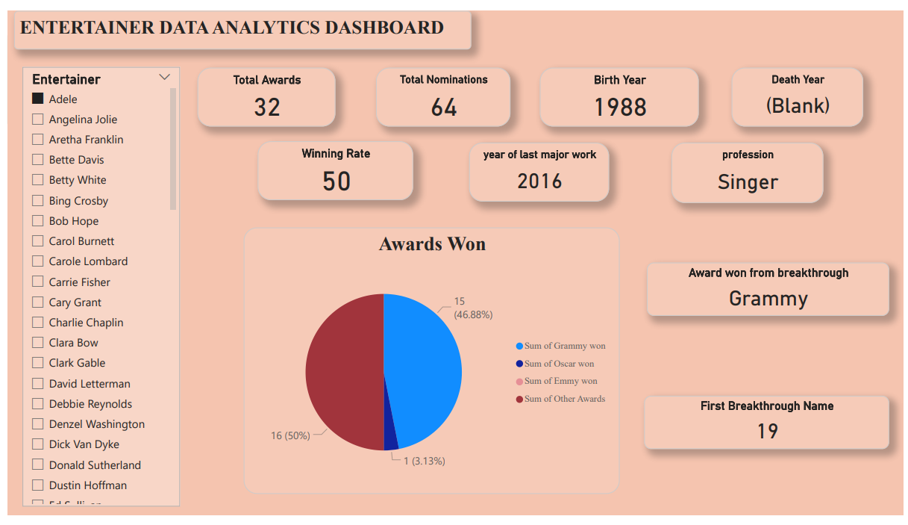
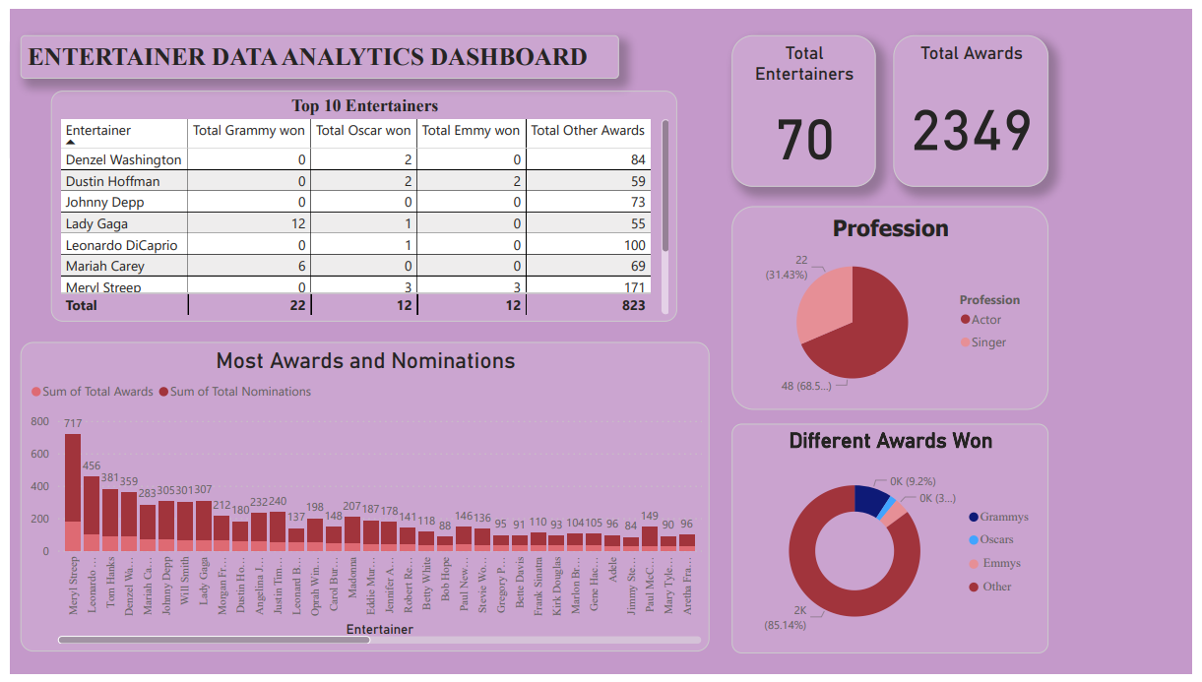
My Design

Slide 8
Benefits​
Entertainer’s filmography can be analysed with a click​
Awards of the entertainers can be consumed by the end user​
Different KPIs will indicate the main information about the entertainer​
Movie count trend or rating of the movies trend over the year can be consumed based on the filters applied

Slide 9
Thank you

